Slide 1

QUANTITATIVE APTITUDE TIME,SPEED & DISTANCE, BOATS & STREAMS

Slide 2
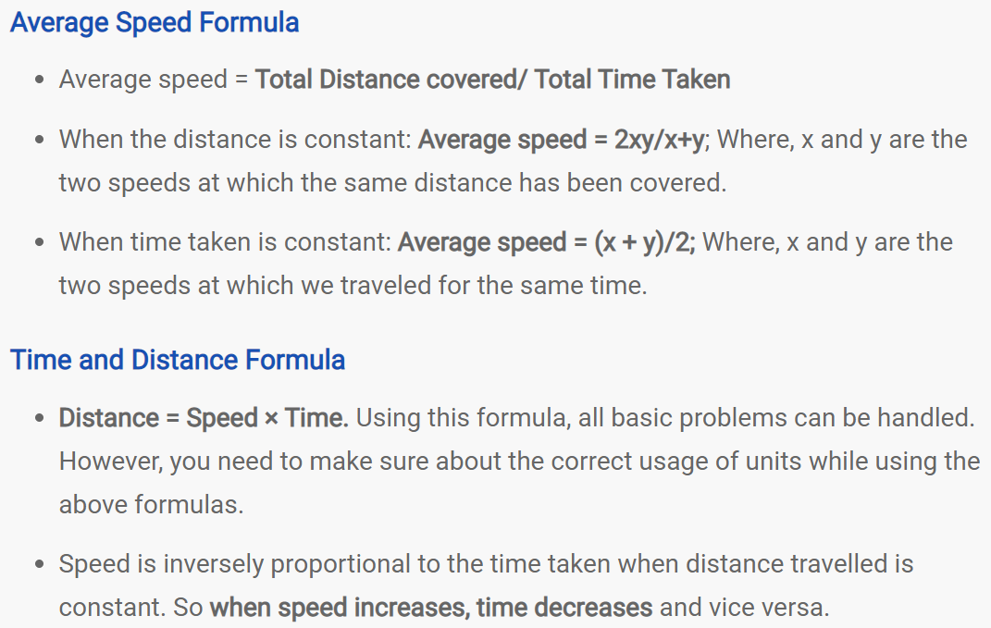

Slide 3
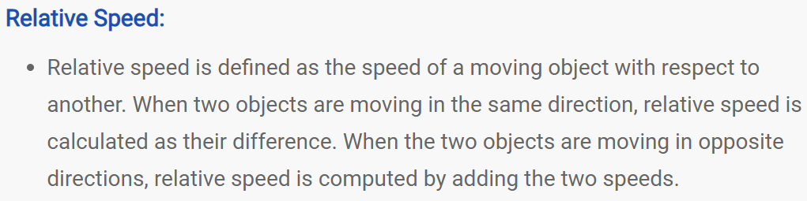
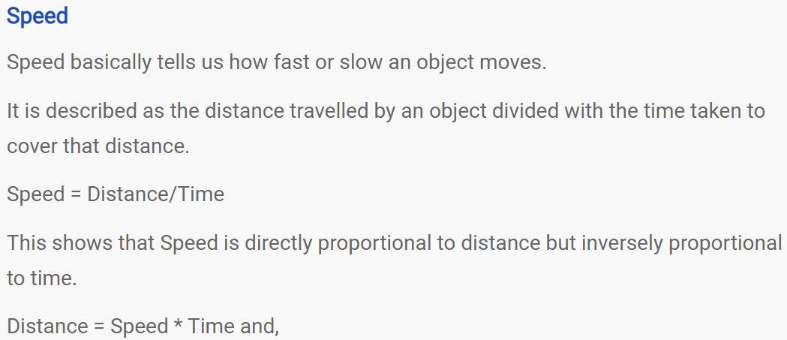

Slide 4
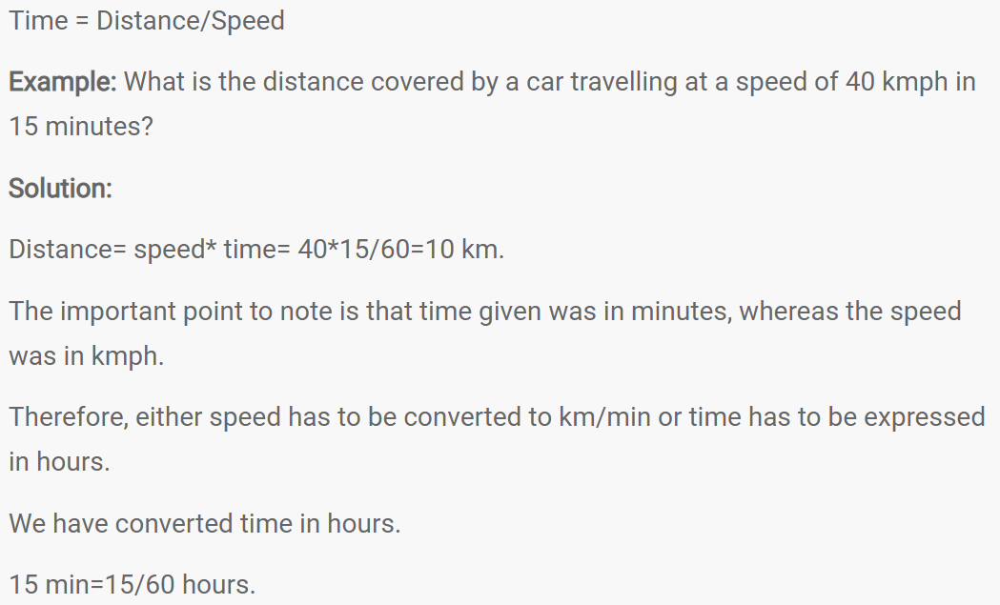

Slide 5
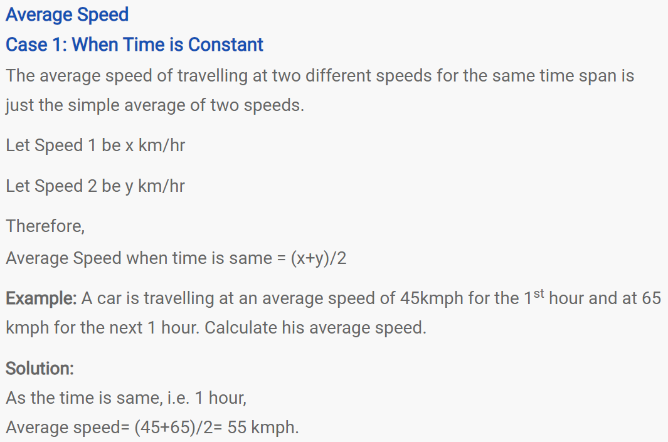

Slide 6
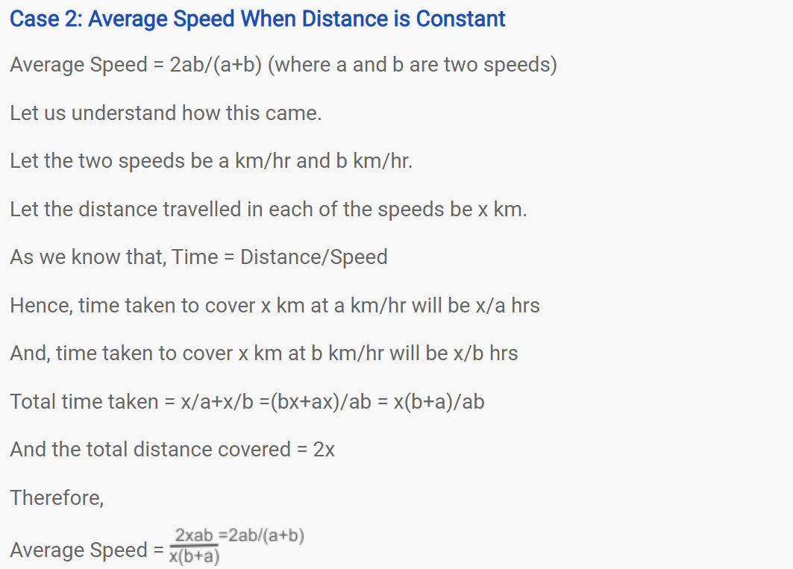

Slide 7
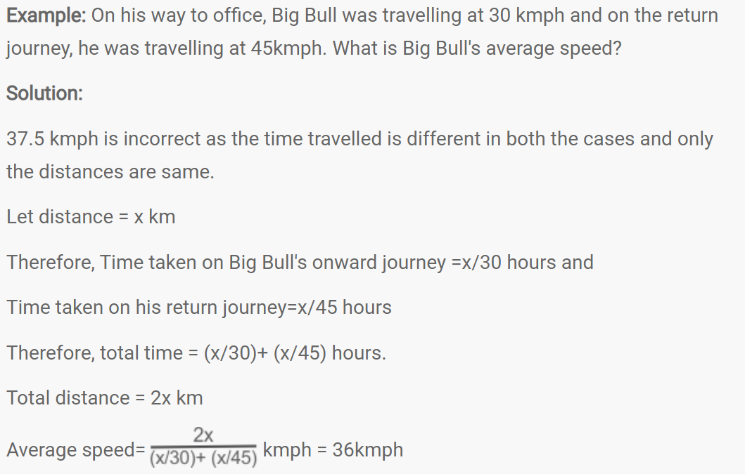

Slide 8
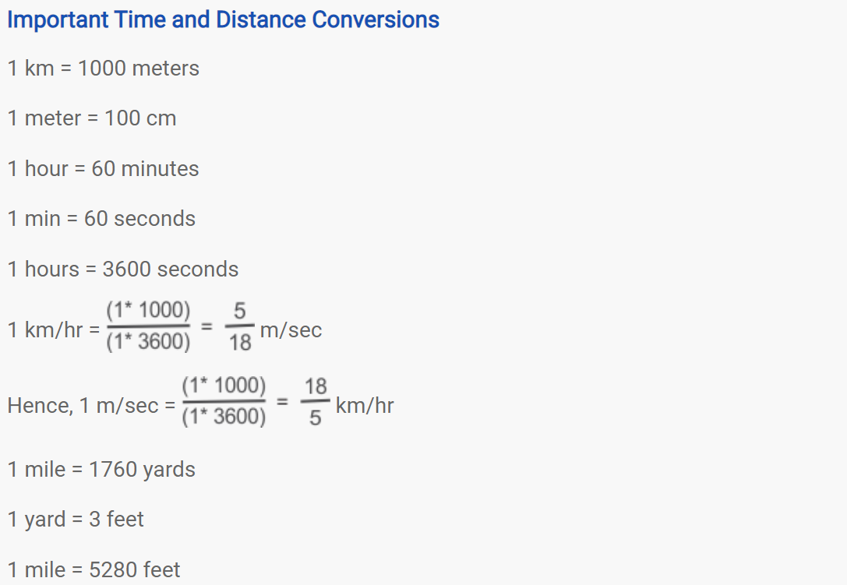

Slide 9
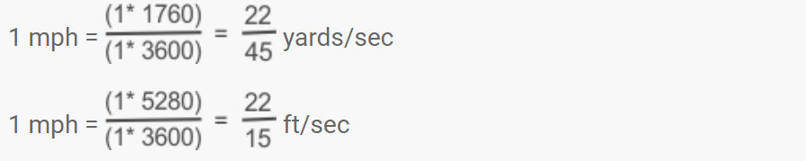
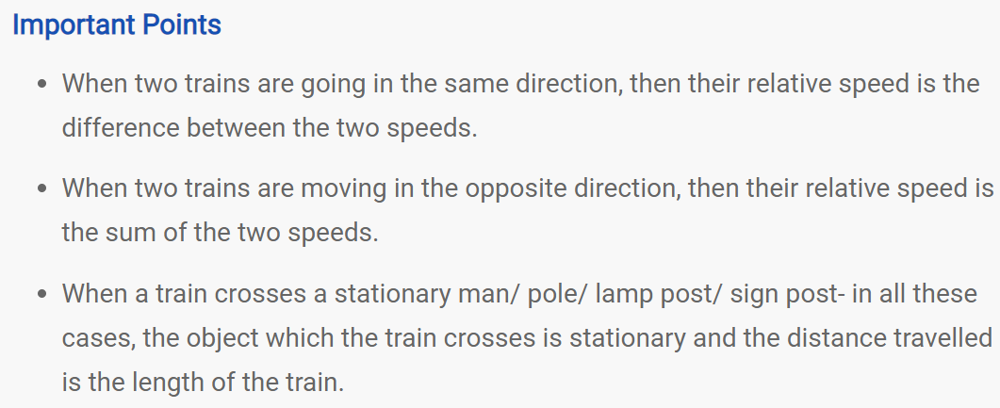

Slide 10
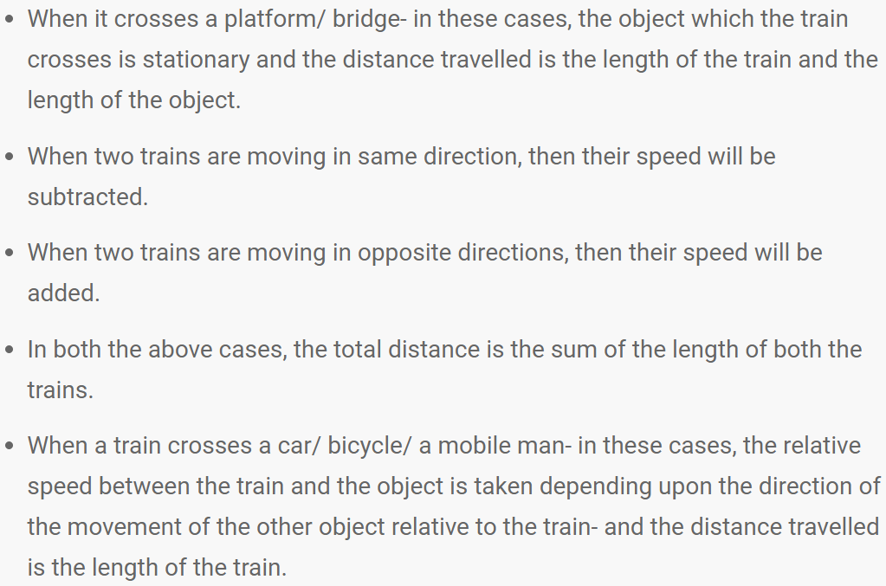

Slide 11
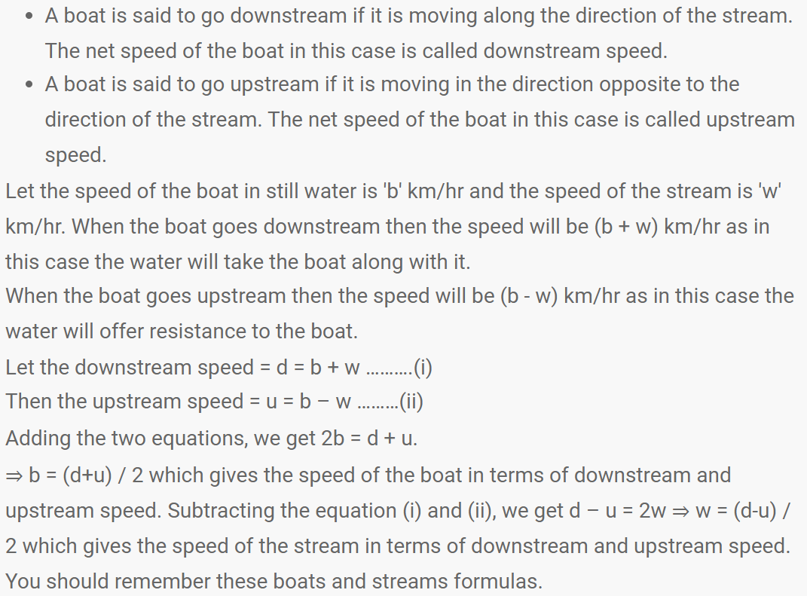

Slide 12
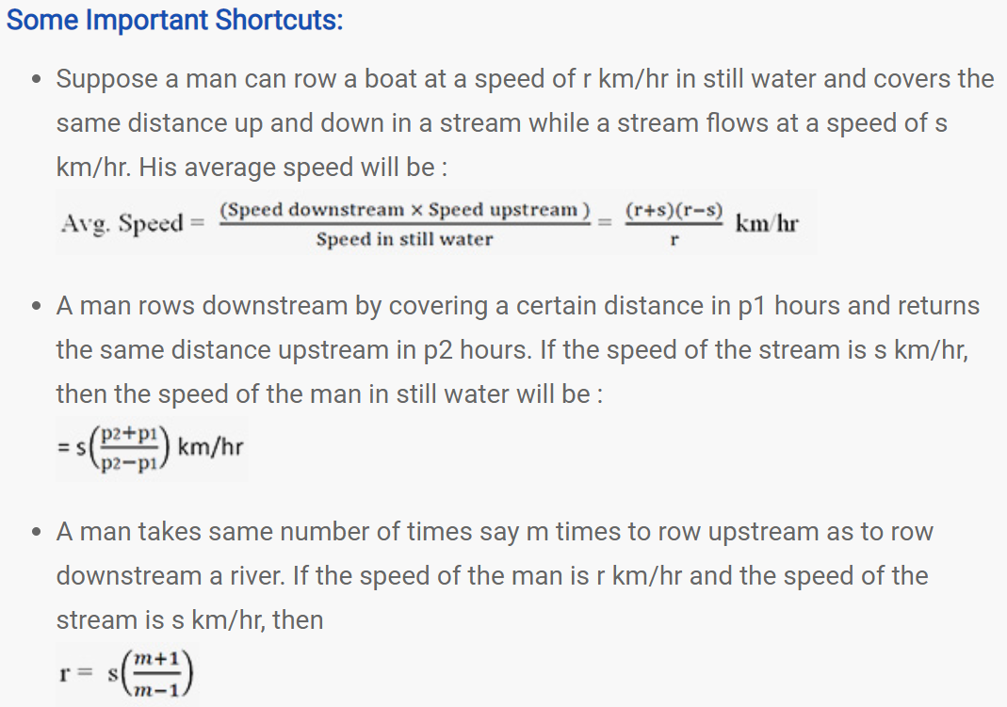

Slide 13
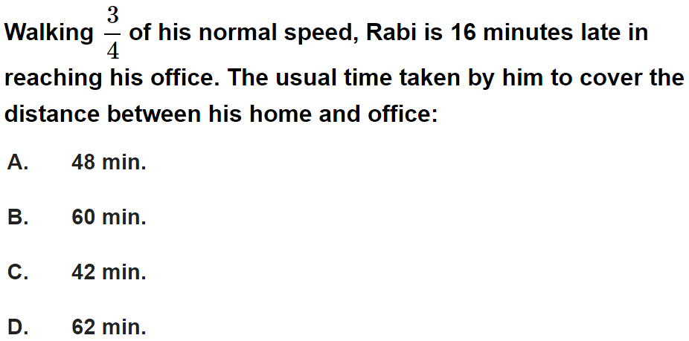
Question No. - 1

Slide 14
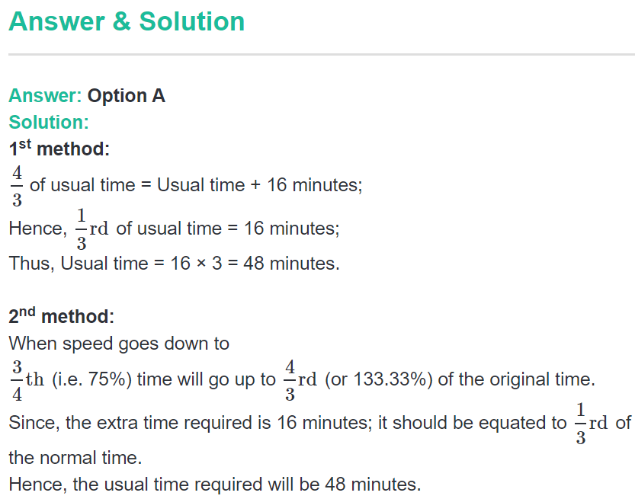

Slide 15
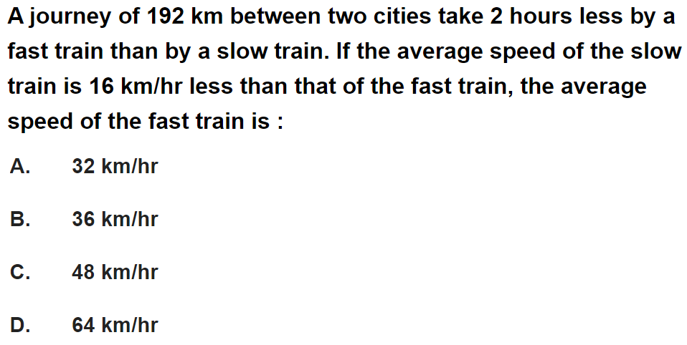
Question No. - 2

Slide 16
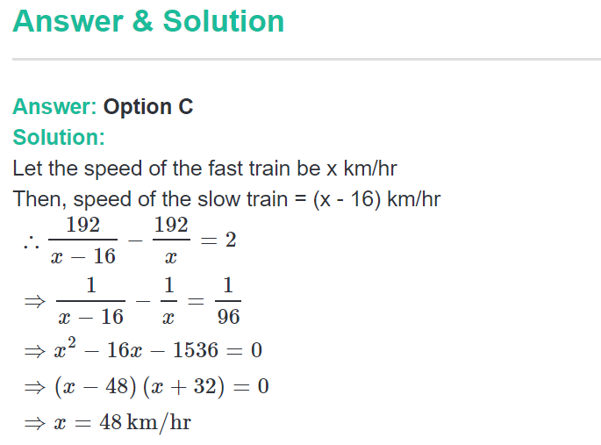

Slide 17
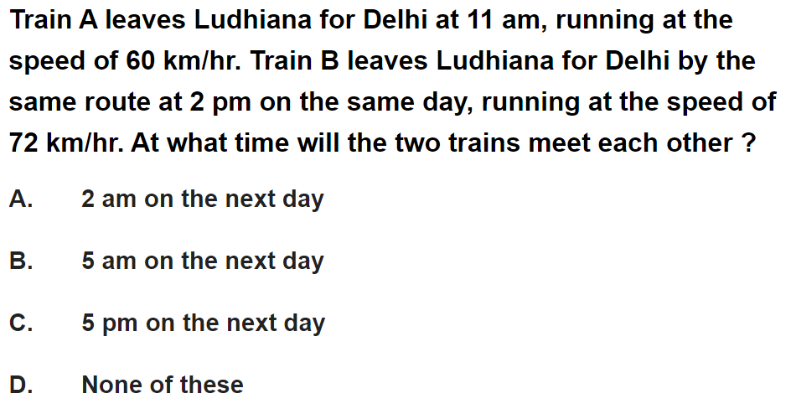
Question No. - 3

Slide 18
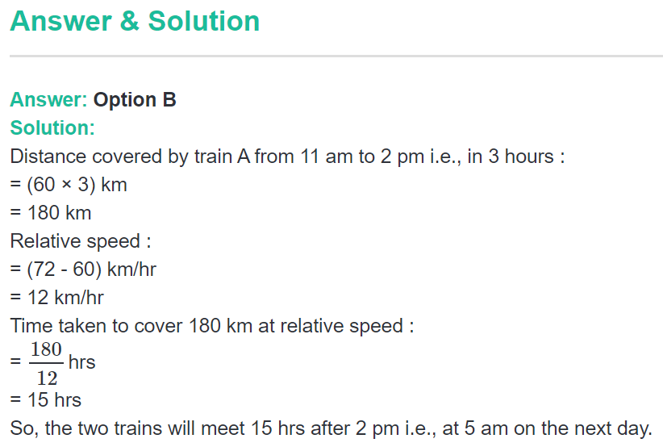

Slide 19
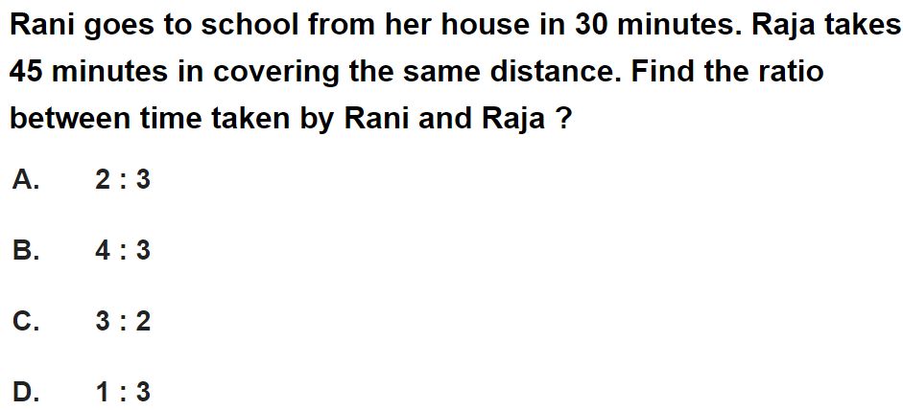
Question No. - 4

Slide 20
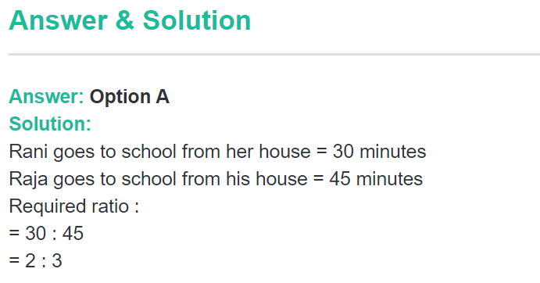

Slide 21
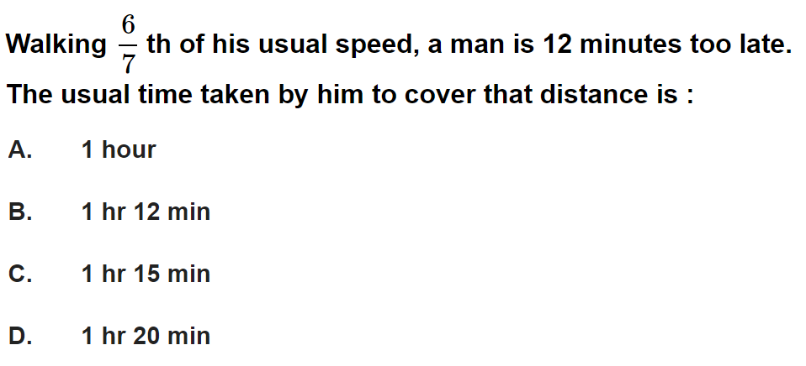
Question No. - 5

Slide 22
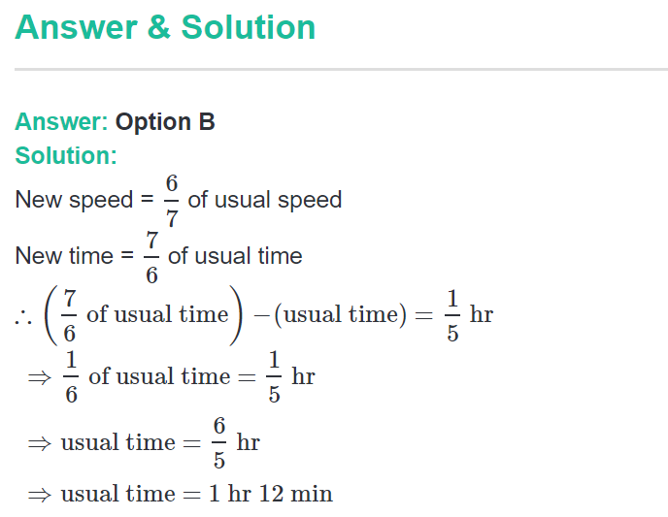

Slide 23
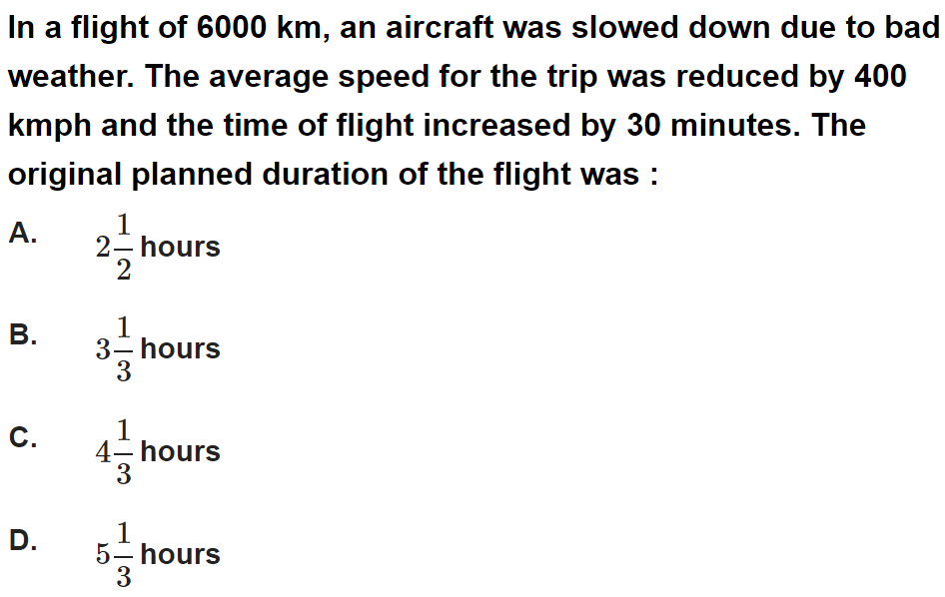
Question No. - 6

Slide 24
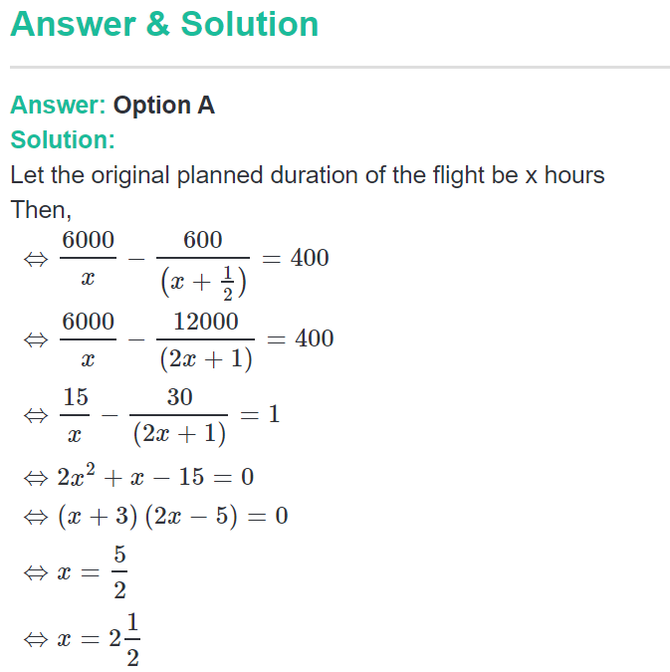

Slide 25
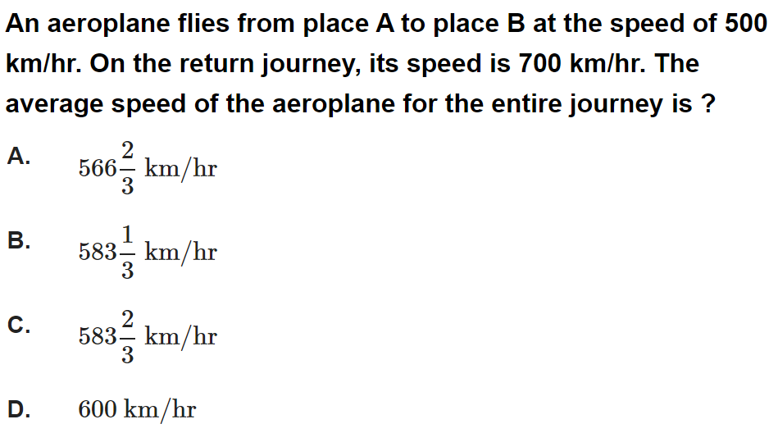
Question No. - 7

Slide 26
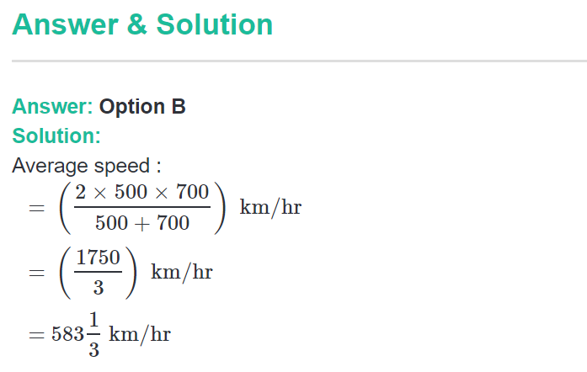

Slide 27
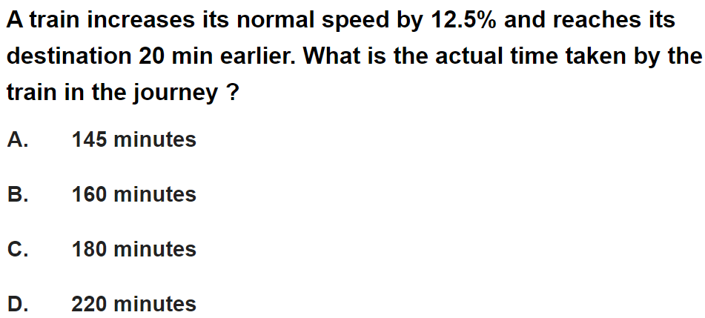
Question No. - 8

Slide 28
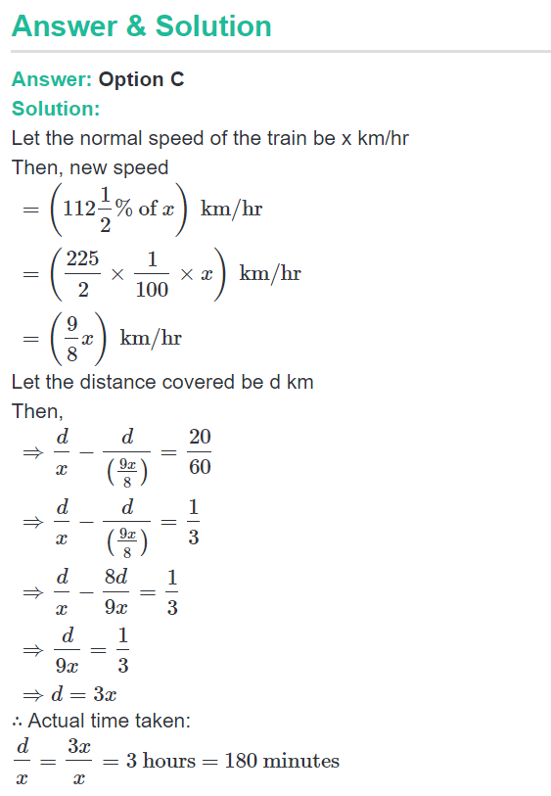

Slide 29
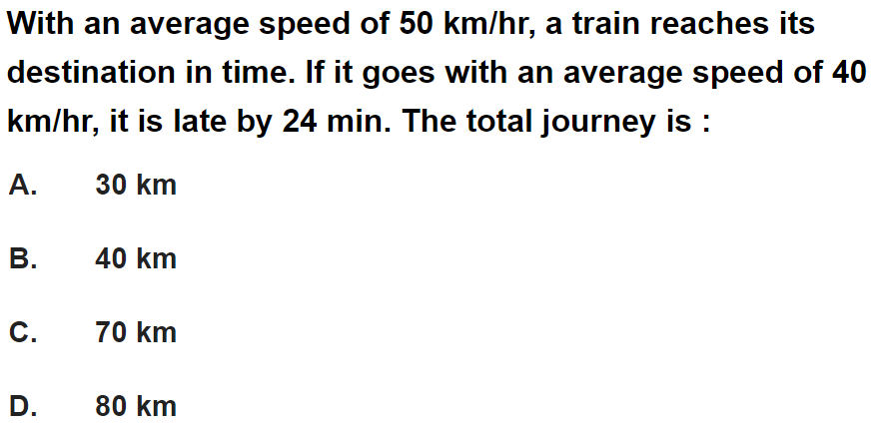
Question No. - 9

Slide 30
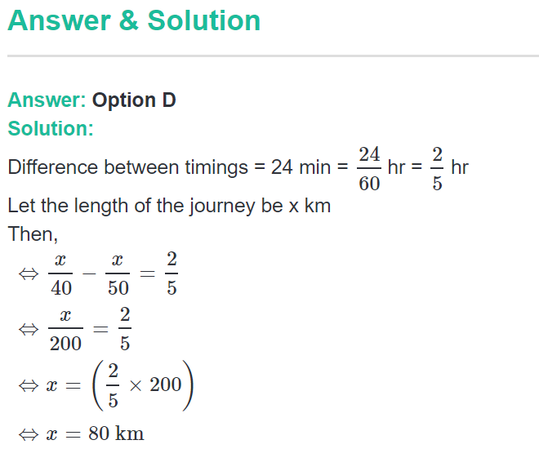

Slide 31
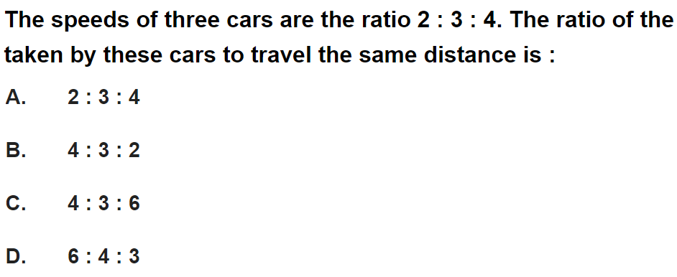
Question No. - 10

Slide 32
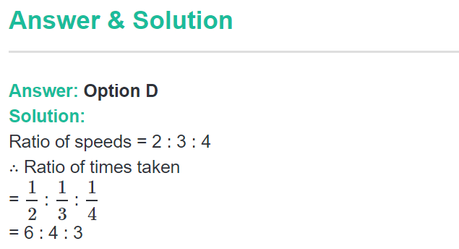

Slide 33
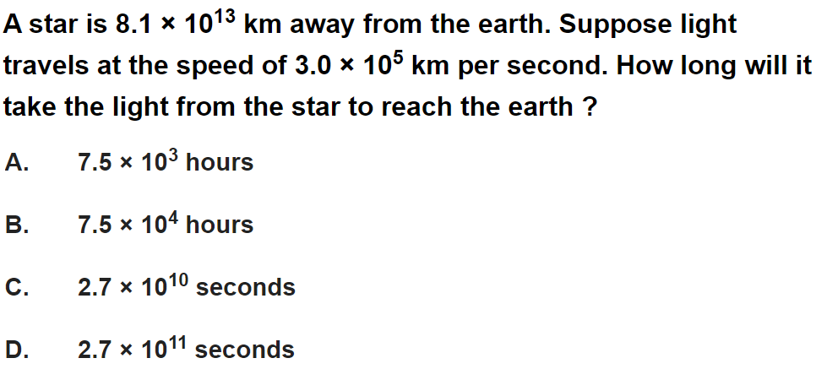
Question No. - 11

Slide 34
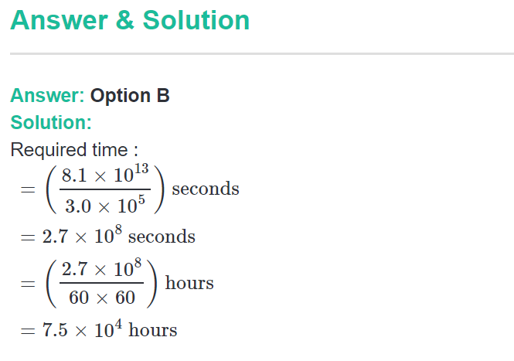

Slide 35
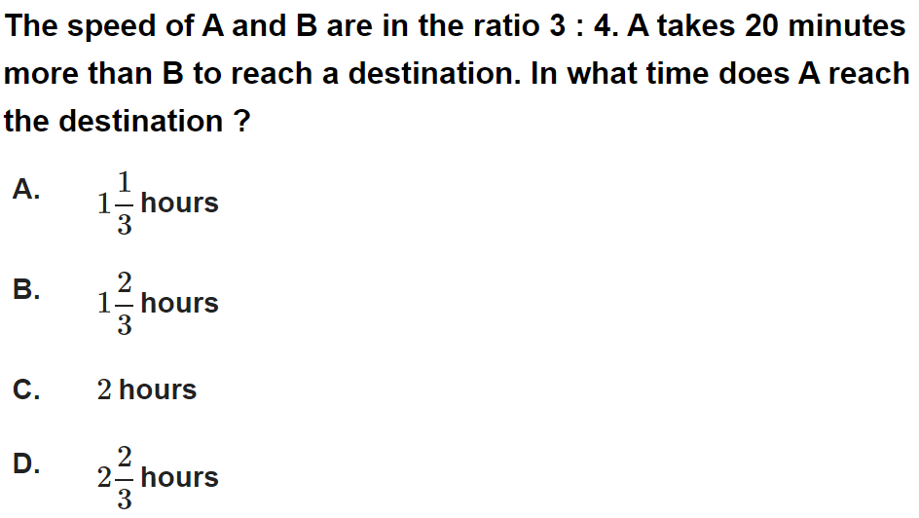
Question No. - 12

Slide 36
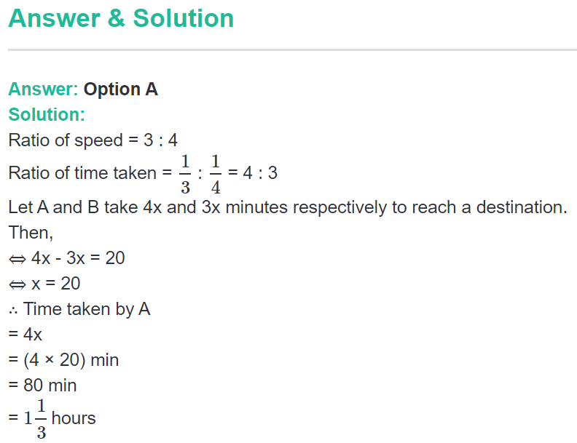

Slide 37
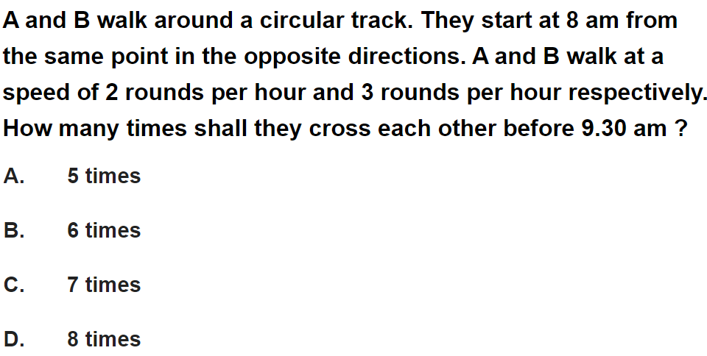
Question No. - 13

Slide 38
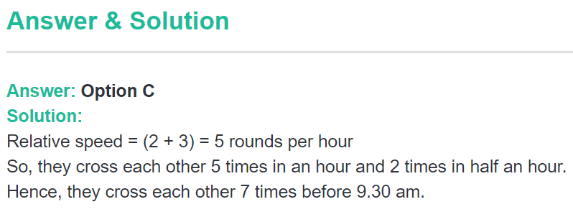

Slide 39
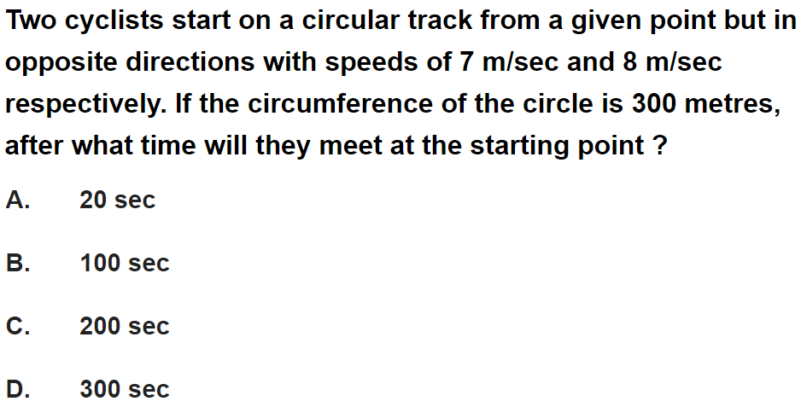
Question No. - 14

Slide 40
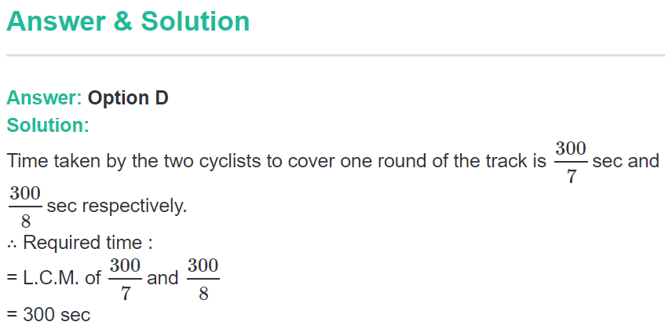

Slide 41
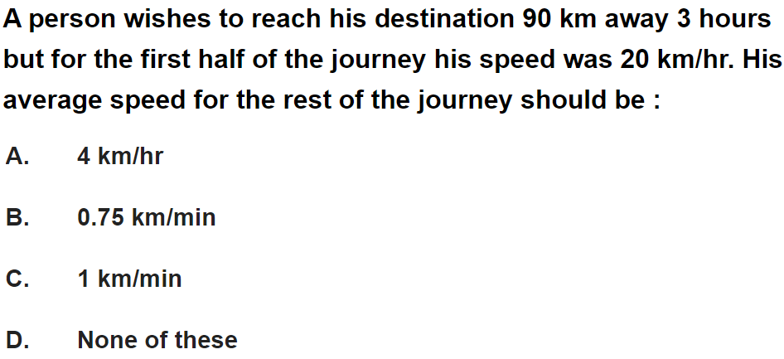
Question No. - 15

Slide 42
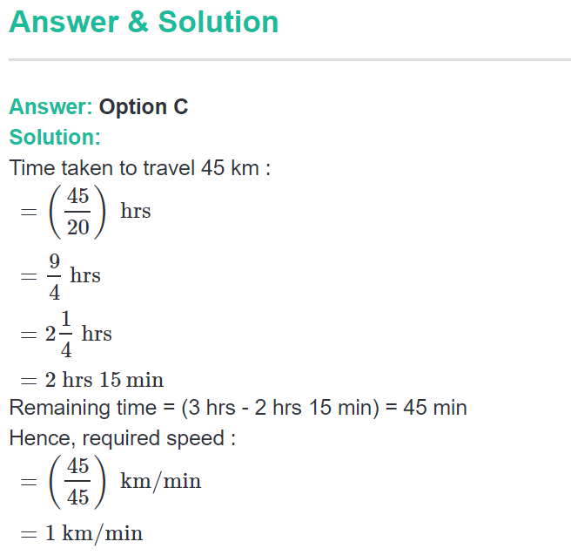

Slide 43
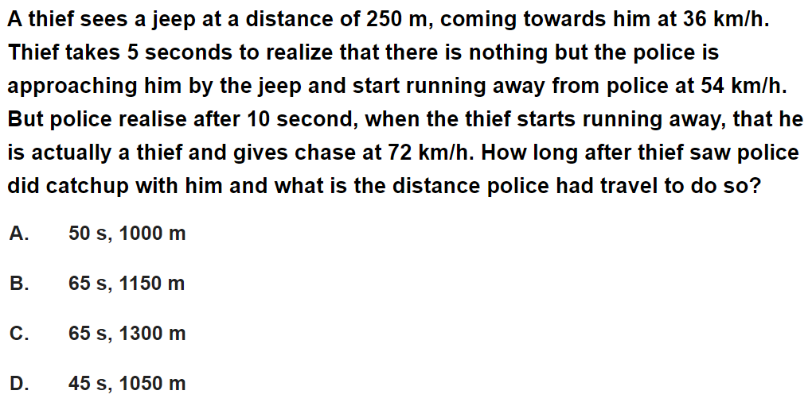
Question No. - 16

Slide 44
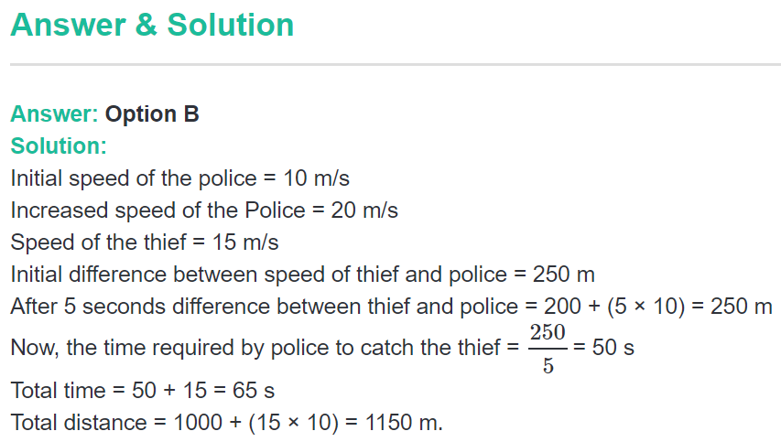

Slide 45
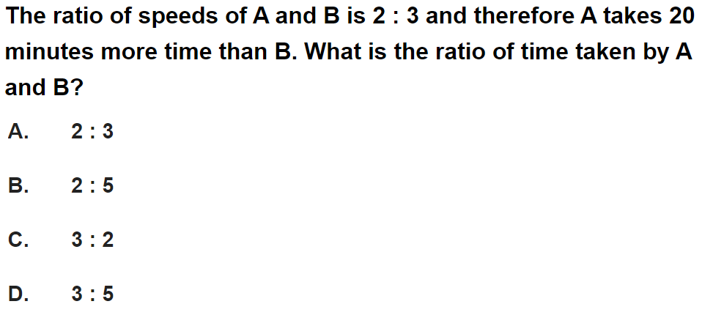
Question No. - 17

Slide 46
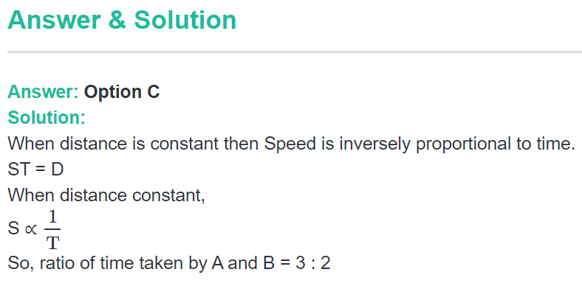

Slide 47
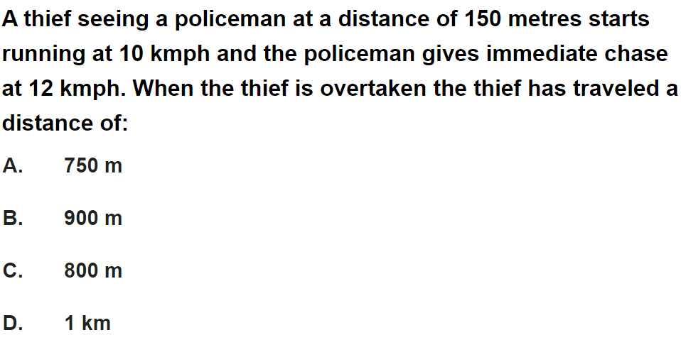
Question No. - 18

Slide 48
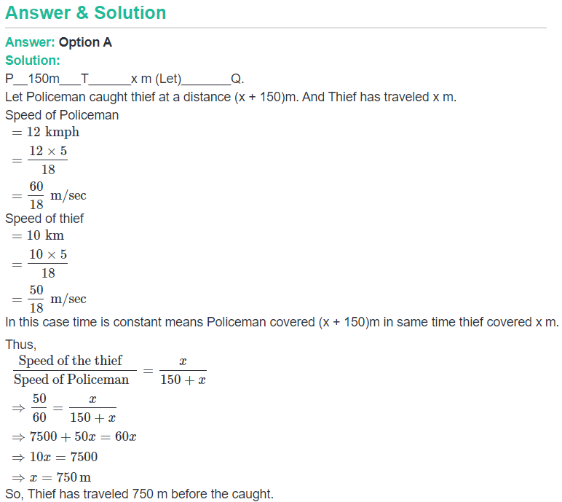

Slide 49
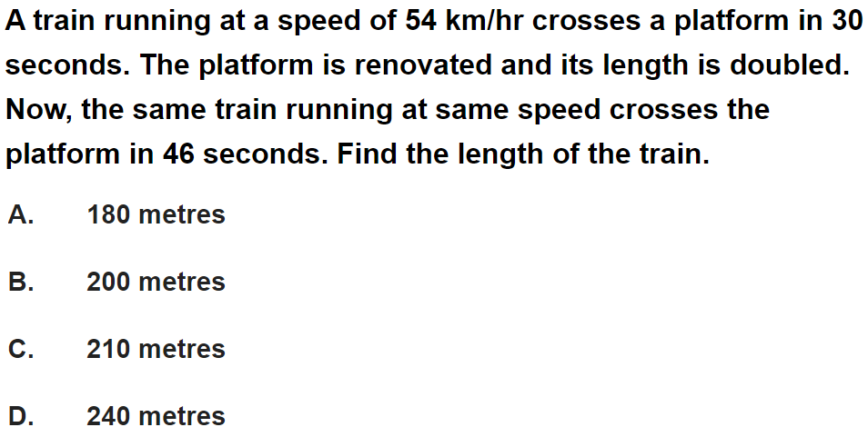
Question No. - 19

Slide 50


Slide 51

Question No. - 20

Slide 52


Slide 53

Question No. - 21

Slide 54


Slide 55

Question No. - 22

Slide 56


Slide 57

Question No. - 23

Slide 58


Slide 59

Question No. - 24

Slide 60


Slide 61

Question No. - 25

Slide 62


Slide 63

Question No. - 26

Slide 64


Slide 65

Question No. - 27

Slide 66


Slide 67

Question No. - 28

Slide 68


Slide 69

Question No. - 29

Slide 70


Slide 71

Question No. - 30

Slide 72


Slide 73

Question No. - 31

Slide 74


Slide 75

Question No. - 32

Slide 76


Slide 77

Question No. - 33

Slide 78


Slide 79

Question No. - 34

Slide 80


Slide 81

Question No. - 35

Slide 82


Slide 83

Question No. - 36

Slide 84


Slide 85

Question No. - 37

Slide 86


Slide 87

Question No. - 38

Slide 88


Slide 89

Question No. - 39

Slide 90


Slide 91

Question No. - 40

Slide 92


Slide 93

Question No. - 41

Slide 94


Slide 95

Question No. - 42

Slide 96


Slide 97

Question No. - 43

Slide 98


